Slide 1
VCF Health and Diagnostics

Slide 2
Importance
With VCF Operations diagnostics, you can quickly diagnose and address issues to minimize their impact and improve operational efficiency, security, and reliability of your VCF platform.
You can discover and remediate known issues, and monitor the operational state of the private cloud infrastructure in VCF Operations Diagnostics.

Slide 3
VCF Health and Diagnostics

Slide 4
Learner Objectives
Outline the role of VCF Health and Diagnostics
Describe the Diagnostic Findings feature
Describe the VCF Health feature
Monitor the operational state of VCF Instances
Explain Troubleshooting Workbench
Enable support teams with full context using Log Assist

Slide 5
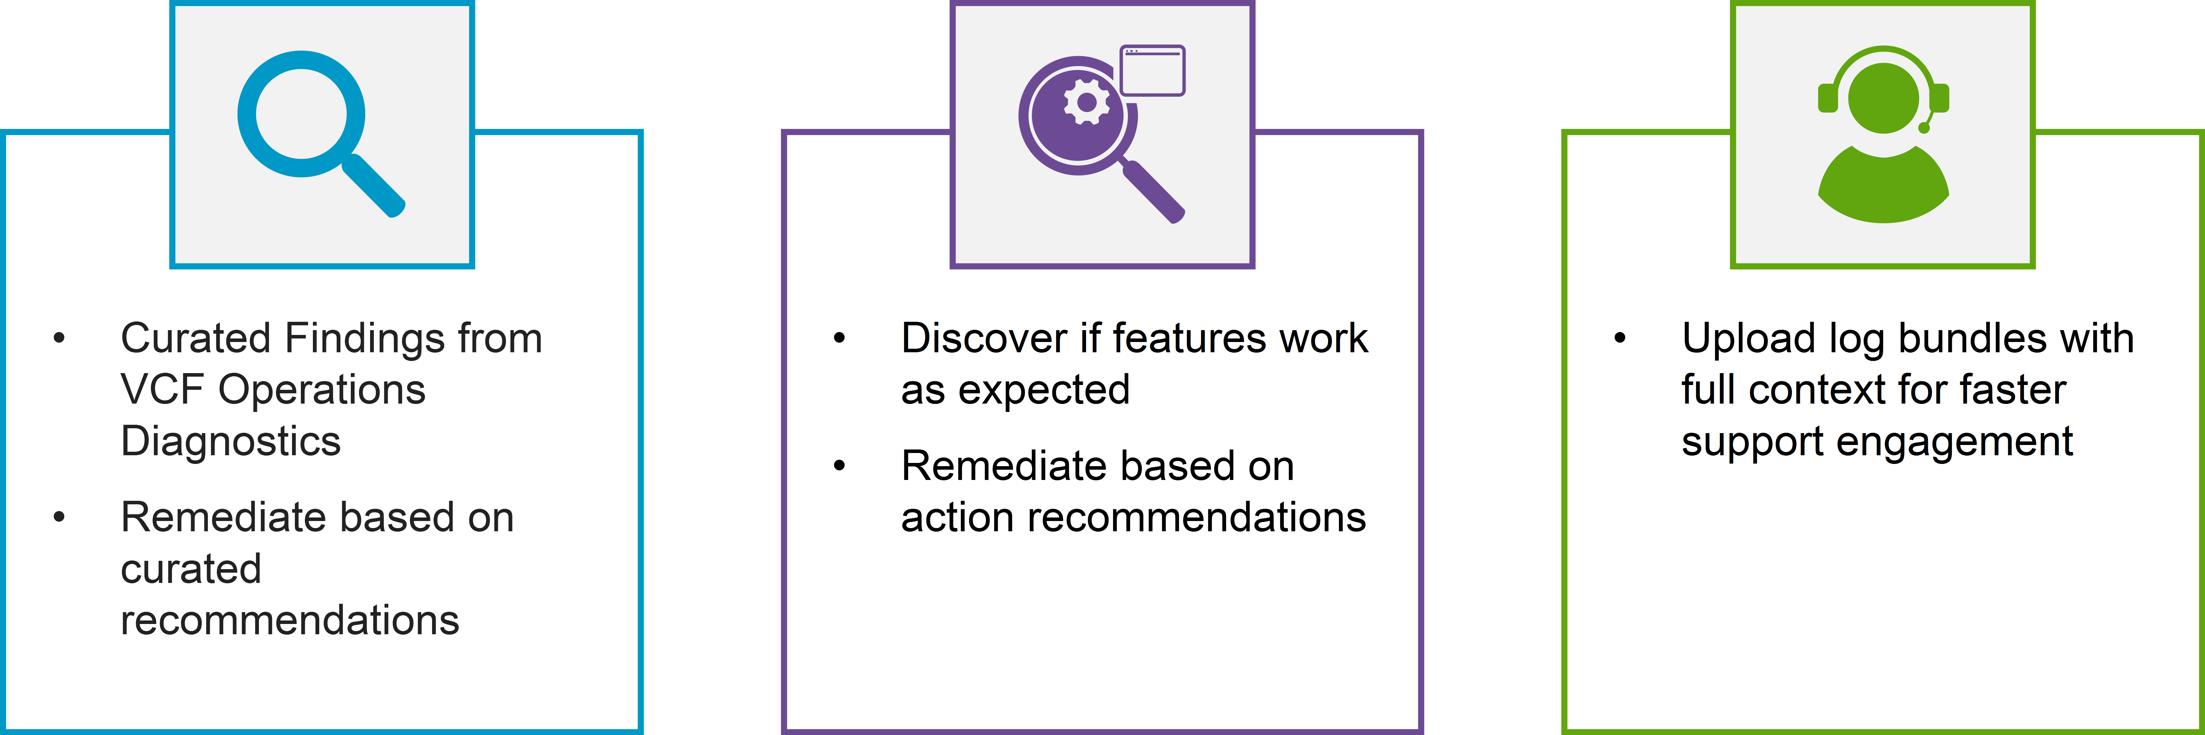
VCF Health and Diagnostics
VCF Health and Diagnostics provides an In-Product experience to discover, troubleshoot, and remediate issues.
Notes:
TalkTrack:
VCF Health and Diagnostics offers an integrated experience to discover, troubleshoot, and resolve issues within the environment. This functionality includes curated findings from VCF Health Advisor, which provides recommendations based on identified issues. It also helps in monitoring the expected operation of features and offers automated recommendations for remediation. For enhanced support engagement, it allows for uploading comprehensive log bundles. VCF Diagnostics extends the capabilities of both cloud-based and on-premise health diagnostic tools, simplifying the administration of private cloud infrastructure. It helps in addressing service request issues, proactively identifying root causes, and avoiding situations that would otherwise necessitate support. VCF Diagnostics addresses the challenges of complex environments in two main ways: through Diagnostic Findings, which enable the discovery of known issues and immediate application of fixes, and through VCF Health, which continuously monitors the operational state of the entire VCF stack.
<End>
How to use VCF Diagnostics to Monitor and Correct Your Environment: With VCF Diagnostics you can use system data such as properties and logs to monitor and correct your VCF environment.
The VCF diagnostics and insight dashboard in VCF Operations predicts potential issues and makes recommendations for remediation. All vSphere component configurations, metrics, and logs are collected and stored in a centralized location, providing an effective tool when troubleshooting an issue.
In VCF 9.0, the functions of VMware Aria Operations and VMware Aria Log Insight have been converted into the VCF Operations. Centralized access for metrics, logs, and configurations provide administrators with a powerful tool to predict, identify, and resolve issues.
VCF Diagnostics builds on the capabilities of the retired cloud self-service tool Skyline Advisor and the on-prem Skyline Health Diagnostic to ease your job as a VCF private cloud infrastructure administrator to keep the entire VCF software stack at a glance and ready to step in quickly for any detected issues, or act proactively on data for potential problems. VCF Diagnostics addresses the top drivers of service support requests to help you avoid situations that would otherwise require support. With Diagnostics, you can take action on the spot as it provides recommendations how to resolve known issues, or narrow down, and even isolate, possible root causes for emerging issues. In case you do not see a known issue reflecting a problem in your environment and you cannot proactively identify such by drilling down to the VCF infrastructure metrics that Diagnostics provides, you can reach out to support, but you do so with proper context and leveraging automated log bundling. VCF environments pose a challenge with their complexity and size to grasp and act on all operational data, but Diagnostics makes this easy by uniting all metrics in a single pane of glass and at the same time providing means of self-support on known issues.
Diagnostics solves the challenge in 2 ways:
Diagnostic Findings, where you discover known issues and can apply fixes on the spot.
VCF Health, where you proactively monitor the operational state of the entire VCF stack.

Slide 6
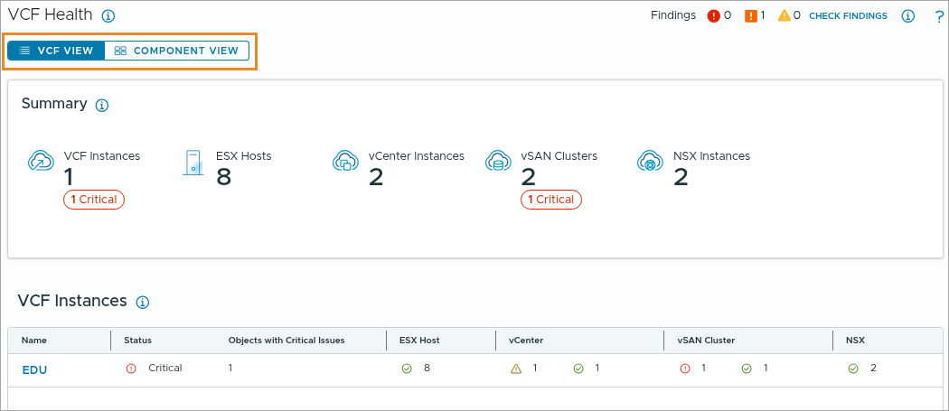
About VCF Health
VCF Health is effectively a consolidated view of your VCF deployment where you can proactively monitor the operational state of your VCF stack.
The structure of VCF Health enables you to navigate the hierarchy from a management domain to its workload domains, vCenter and NSX instances, vSAN clusters, and ESX hosts.
The VCF Health screens cover the top support ticket drivers, such as expiration of certificates, to avoid support requests, eliminate downtime, and increase resilience.
Notes:
TalkTrack:
VCF Health provides a consolidated view of your VCF deployment, enabling proactive monitoring of its operational state. The structure of VCF Health mirrors the hierarchy of your management domain, including SDDC domains, VCF instances, vSAN clusters, and ESX hosts. It offers a Component View, providing a holistic summary of all objects within your environment. Additionally, a VCF Health View allows for detailed drill-down into the inventory tree, from the management domain all the way down to individual ESX hosts. VCF Health significantly contributes to reducing support requests and enhancing resilience. It addresses critical issues such as expiring certificates, misconfigured NTP/DNS settings, and general misconfigurations, helping to prevent situations that would typically require support intervention. It also provides trending information for vMotion and helps manage networking and configuration issues. For critical issues, diagnostic findings are presented, allowing for immediate, on-the-spot fixes. Ultimately, VCF Health helps to proactively monitor the operational state of the entire VCF stack.
<End>
The VCF Health screens cover the top support ticket drivers, such as expiration of certificates, to avoid support requests, eliminate downtime, and increase resilience. For example, if you see all expiring certificates at a glance or if you monitor the NTP and DNS sync, you can avoid networking and configuration issues. Or if you see a trend of failing tasks with virtual machine snapshots or vSphere vMotion migrations, you can handle the underlying cause for an emerging negative trend to prevent issues from occurring.
For more information, refer to the KB article What is Diagnostics for VMware Cloud Foundation
VCF View vs Component View With VCF Health, private cloud infrastructure administrators can monitor the entire VCF stack in depth and breadth that goes beyond the capability of any of the legacy VMware products.
VCF Health gives two starting points for monitoring:
The Component View: which provides a holistic view summarizing all objects in your environment.
The VCF View: which allows a drill-down in the inventory tree from a management domain down to a single ESX host.
VCF Health screens are structured to help you with the most critical steps in setting and maintaining a VCF system, based on data from support requests.
For example, setting up certificates, NTP sync, and DNS reverse lookup from an operational point of view, or tracking the performance of vCenter instances from an infrastructure point of view. You can drill down to each card that summarizes a VCF operational metric into an individual dashboard or panel in VCF Operations by following the View Dashboard or View Details link. Note: VCF Health provides data only on active inventory objects. If you delete a resource, all related events are deleted immediately.(MOPSC-20214)

Slide 7
Unified Health and Diagnostics for VCF
Diagnostics for VMware Cloud Foundation is designed to help you analyze and troubleshoot the most common capabilities of VCF components.
Notes:
TalkTrack:
Diagnostics for VMware Cloud Foundation is designed to assist in analyzing and troubleshooting common capabilities of VCF components. This feature is adept at detecting prevalent issues within an environment and providing actionable findings for diagnosis and resolution. It offers self-help workflows specifically for vCenter capabilities to aid in problem diagnosis. Current capabilities covered by Diagnostics include vMotion, Snapshots, and Workload Provisioning. The VCF Diagnostics and Health framework encompasses two main areas: VCF Components and VCF Capabilities. VCF Components include elements such as vCenter, ESX Host, vSAN, NSX, VCF Ops Platform, VCF Automation Platform, VDB, HCP, and WCP. VCF Capabilities refer to functions like vMotion, DRS, HA, Snapshots, Workload Provisioning, and Domain Provisioning. The system also identifies common issues such as VMSA (VMware Security Advisory) alerts, guest password expiration, NTP drifts, DNS issues, and configuration maximum deviations. All these functionalities are delivered via the VCF Operations Platform, which is a unified operations platform. In VCF 9.0, the Diagnostic Findings and VCF Health flows are managed separately. The VCF Self-Health feature can be accessed through the left navigation pane under Infrastructure Operations. The Diagnostic Findings flow incorporates best practice findings, a rule library, and over 500 property-based and log-based rules. Efforts are also underway to integrate functions from Skyline Advisor and Skyline Health Diagnostics into VCF. These capabilities are driven by business needs to expand the visibility of the overall health of the environment, enable customers to quickly identify problems and reduce recovery time from incidents, and provide focused guidance directly within the VCF Admin Console to streamline troubleshooting workflows.
<End>
Diagnostics for VMware Cloud Foundation helps analyze and troubleshoot common VCF components. This feature detects typical problems in your environment and presents them as findings for you to diagnose and resolve. It offers relevant information through self-help flows for vCenter capabilities (e.g., vMotion) to assist in diagnosing issues. Currently, Diagnostics for VMware Cloud Foundation covers vMotion, Snapshots, and Workload Provisioning. For more information, refer to the KB article Diagnostics for VMware Cloud Foundation Findings
Business Drivers Expand the capabilities to show the overall health of the environment Enable customers to rapidly identify problems in VCF components and capabilities thereby either reducing time to recover from an issue or preventing its occurrence. Help customer by enabling troubleshooting workflows and focused guidance directly within VCF Admin Console.
The VCF Operations console consolidates the health of the VCF components and services into one dashboard, providing a simplified platform to identify and troubleshoot issues.
You can view issues related to:
VCF components such as vCenter and ESX
VCF services such as vMotion and Snapshots
Common infrastructure issues such as NTP drifts, DNS misconfigurations, and so on
You can view issues related to the following components and services:
VCF components:
vCenter, ESX, Workload Control Plane (WCP)
vSAN
NSX
VCF Automation
VCF services:
vMotion, HA, DRS
Snapshots
Workload Provisioning and Domain Provisioning
Infrastructure:
Certificate and passwords
Policy compliance
NTP and DNS

Slide 8
Setting Up and Maintaining VCF Operations diagnostics
You complete VCF Operations diagnostics for your VCF environment by installing and configuring VCF Operations for logs and setting up integration between components.
VCF Health works solely on systems deployed by using the VCF Installer and requires a VCF license:
The Diagnostic Findings capability has no license dependency and works on both VMware vSphere Foundation and VCF.
You can apply only the diagnostic capabilities relevant to your setup.
Notes:
TalkTrack:
To set up and maintain VCF Operations diagnostics, one must install and configure VCF Operations for logs, then set up component integrations. VCF Health is deployed via the SDDC Manager and requires a VCF license. The Diagnostic Findings capability has no license dependency and functions across both VMware vSphere Foundation (VMware vSphere Foundation) and VCF. VMware vSphere Foundation offers a subset of VCF capabilities that apply to VMware vSphere Foundation environments. It is important to apply only diagnostic capabilities relevant to the specific setup, for example, if NSX is not in an environment, NSX integration is not needed. If an SDDC Manager is not present, Diagnostic Findings will not be available. The Management Pack for VCF Diagnostics installs automatically, eliminating the need for manual configuration to begin data collection. Setting up VCF Health involves several steps: Deploy VCF Operations for Logs with a VCF license using the Fleet Management and Lifecycle section. Configure log collection from VCF inventory objects, such as vCenter instances, into VCF Operations for Logs. Add a Unified Cloud Proxy to facilitate log collection into the log cluster and enable support bundle uploads to the Broadcom Support Portal, found under Administration, Cloud Proxies. Ensure network connectivity between VCF Operations and endpoints like ESX, vCenter, NSX, and SDDC Manager for Log Assist. The connection originates from the cloud proxy, not the cluster node. For VCF Operations for Logs, the required port is 9543, with a minimum bandwidth of 200 KB/s. Diagnostic findings are generated based on the following adapters: vCenterAdapter (VMware Cloud Foundation), VMware (vCenter Adapter), NSXTAdapter (NSX), and CASAdapter (VCF Automation for vR Ops Organization, formerly vRealize Automation Adapter). For findings related to earlier versions of VCF Automation, the VCF Automation for vR Ops Organization adapter must be added and activated from Repository, Integrations, an account created, and added to a Default Collector group.Diagnostic findings for VCF components are only displayed if their corresponding adapters are actively collecting data.
<End>
The Management Pack for VCF Diagnostics is automatically installed and the integration does not require manual configuration, but some VCF components need installation or integration, by using adapters, to become active and collecting diagnostics data.
The Diagnostic Findings capability has no license dependency and works on both VMware vSphere Foundation and VCF: VMware vSphere Foundation provides a subset of the VCF capabilities, and any feature that applies to VCF also applies to VMware vSphere Foundation within the scope of your environment.
You can apply only the diagnostic capabilities relevant to your setup: For example, if you do not use NSX in your environment, you do not need to take care of the NSX integration. You also do not need to have an SDDC Manager in your environment for Diagnostic Findings to work.
Steps to setup VCF Health:
Go to Fleet Management > Lifecycle to deploy VCF Operations for Logs with a VCF license.
Go to Configurations > Log Collection to configure log collection into VCF Operations for Logs from VCF inventory objects, such as vCenter instances.
Go to Administration > Cloud Proxies > Add to download and deploy a Unified Cloud Proxy that facilitates log collection and the Log Assist capability. You use a Unified Cloud Proxy to collect logs into the log cluster and to collect and upload support bundles to the Broadcom Support Portal.
Make sure you have connectivity between components in your environment. The networking port required between VCF Operations and endpoints in ESX, vCenter, NSX, and SDDC Manager is SSL 443. For Log Assist, the connection is between the cloud proxy and the respective component, not from the cluster node.
For the VCF Operations for Logs, the required port is 9543. The minimum bandwidth is 200 KB/s.
Generation of diagnostic findings depends on the following adapters:
VcfAdapter (VMware Cloud Foundation)
VMWARE (vCenter Adapter)
NSXTAdapter (NSX)
CASAdapter (VCF Automation for VM Apps Organization, formerly vRealize Automation Adapter)
For findings related to earlier versions of VCF Automation, you must add and activate the VCF Automation for VM Apps Organization adapter from the Repository at Administration > Integrations, create an account and add it to a Default Collector group.

Slide 9
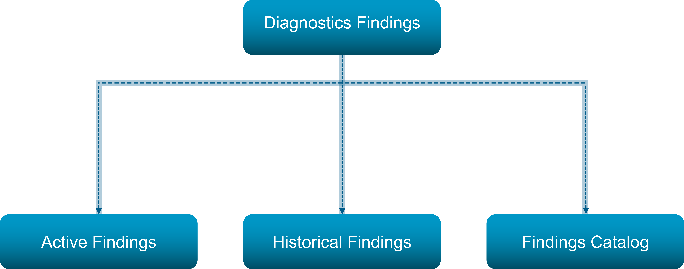
About Diagnostic Findings
Diagnostic Findings consolidates a list of log and property-based findings with specific resolution, also called diagnostic rules or signatures.
Notes:
TalkTrack:
Diagnostic Findings consolidates a list of log and property-based findings with specific resolution, also called diagnostic rules or signatures. These findings are a type of alert, without notifications, that result from a scan of the environment by the Diagnostics Management Pack. This scan is based on VMware best practices, logs, and properties that match known issues. Diagnostic Findings integrates with VMware Cloud Foundation Operations for logs, providing greater depth and flexibility in troubleshooting. It is important to review the findings and decide on the next appropriate steps for the VMware environment. Findings differ from reports on the operational state of a system, such as connectivity, services status, or interface issues. Property-based findings inform about issues that might affect the environment. Log-based findings provide information if an issue has already affected the system. Diagnostics 9.0 operates with more than 600 property and log-based rules. A comprehensive list of all signatures is available in the Findings Catalog.
<End>
In the Diagnostics Findings screen, you can see Active Findings that shows all the findings discovered within the last 24 hours, Refresh Findings allows you to perform real-time analysis using the product logs in your environment where the problem has occurred, and in the Findings Catalog tab, you see the complete list of signatures that are checked in your environment at any given time.
Diagnostic Findings provides a powerful graphical representation of alerts that are categorized by severity level.
If you have used Skyline Advisor and Skyline Health Diagnostic, you are familiar with the notion of diagnostic findings, but if you are not, findings are a type of alert, without notifications, that result from a scan of your environment by the Diagnostics Management Pack on VMware best practices, logs, and properties that match a particular known issue.
You see what are the affected objects and the recommendation for resolution, and a link to a knowledge base article (KB). Diagnostic Findings consolidates a list of log and property-based findings with specific resolution, also called diagnostic rules or signatures, from Skyline Advisor and Skyline Health Diagnostics, and integrates VMware Cloud Foundation Operations for logs to provide more depth and flexibility in troubleshooting. You review the findings and decide on the next steps appropriate for your VMware environment. Findings are different from reports on the operational state of a system, such as connectivity, services status or interface issues. Property-based findings inform you about issues that might affect your environment. Log-based findings inform you if an issue has already affected your system. Diagnostics 9.0 works with more than 600 property and log-based rules. You can see a list of all signatures in the Findings Catalog.

Slide 10
Architecture Diagram and Data Flow of Diagnostic Findings
Diagnostics Findings collects data from all VMware Cloud Foundation platform components such as properties and logs that help you identify existing or potential issues in your environment.
Notes:
TalkTrack:
Diagnostic findings provide proactive delivery of new findings and automatic updates. Signatures and updates are delivered from the Broadcom Software Depot over the internet to the VCF Operations Platform, which includes the Diagnostics Management Pack, VCF Operations, and Logs components. This platform interacts with an internet connected environment, including vCenter, ESX, vSAN, and NSX. Diagnostic findings are a type of alert, distinct from notifications, that result from a scan of the environment by the Diagnostics Management Pack. These findings are based on VMware best practices, logs, and properties that indicate known issues. Diagnostic Findings consolidates a list of log and property-based findings with specific resolutions, also known as diagnostic rules or signatures. These findings integrate with VMware Cloud Foundation Operations for logs, providing enhanced depth and flexibility in troubleshooting.
<End>
Diagnostics findings are derived from properties and product log data from vCenter, ESX, NSX, SDDC Manager, VCF Operations, vSAN, and VCF Automation that help you identify potential problems or inform you about existing issues in your environment, and provide steps to resolve them.
If you have used Skyline Advisor and Skyline Health Diagnostic, you are familiar with the notion of diagnostic findings, but if you are not, findings are a type of alert, without notifications, that result from a scan of your environment by the Diagnostics Management Pack on VMware best practices, logs, and properties that match a particular known issue.
You see what are the affected objects and the recommendation for resolution, and a link to a knowledge base article (KB). Diagnostic Findings consolidates a list of log and property-based findings with specific resolution, also called diagnostic rules or signatures, from Skyline Advisor and Skyline Health Diagnostics, and integrates VMware Cloud Foundation Operations for logs to provide more depth and flexibility in troubleshooting. You review the findings and decide on the next steps appropriate for your VMware environment. Findings are different from reports on the operational state of a system, such as connectivity, services status or interface issues. Property-based findings inform you about issues that might affect your environment. Log-based findings inform you if an issue has already affected your system. Diagnostics 9.0 works with more than 600 property and log-based rules. You can see a list of all signatures in the Findings Catalog.

Slide 11
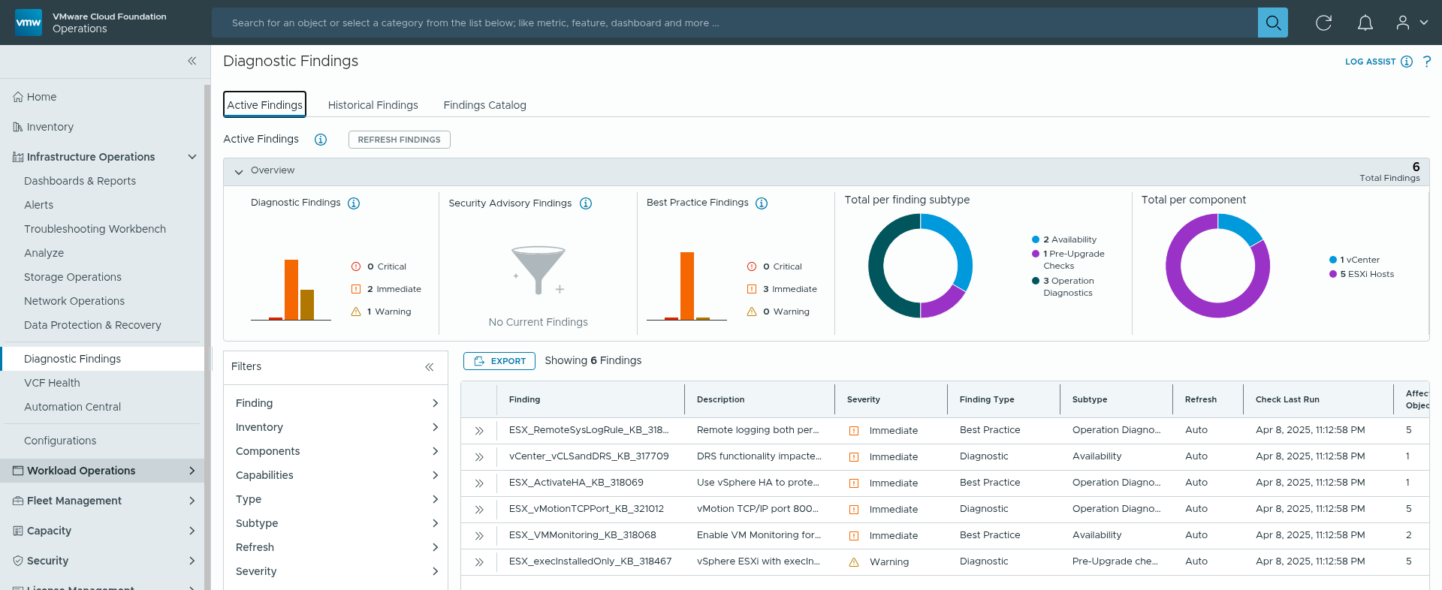
Active Findings
Checks against property-based signatures run every 4 hours, scanning your VCF environment. Within 24 hours, whenever a condition in your setup matches a signature, it appears in the Active Findings grid.
Notes:
TalkTrack:
The Diagnostic Findings capability offers a strong visual representation of alerts, categorized by their level of criticality. VCF Operations version 9.0 incorporates a powerful rule engine for diagnostics, designed to analyze log information and generate comprehensive reports. Based on rule evaluations and scans of log data, the system produces events that are managed externally, which are then presented as findings. The Active Findings section displays a current list of detected issues related to known problems. Historic Findings, on the other hand, review log-based signatures for a specific period in the past.
<End>
VCF Operations 9.0 provides a powerful diagnostic rule engine for analyzing logs and providing detailed reports. Based on rule evaluation and log scans, externally managed events are produced, representing findings. Proactive delivery of new findings and automatic updates.
The Active Findings section displays a list of issues detected for a known problem. Historic Findings evaluate log-based signatures for a specified time in the past.
When you expand a finding in the grid, you see:
a summary and description of the identified issue
the affected objects with links that take you to an object summary page
recommendations how to handle the issue, either specific steps or a KB
In addition to the scheduled property-based scans, within the 24-hour window of Active Findings, you can run on demand log-based checks by using the Refresh Findings option. With that option, you can narrow down the scope of your monitoring to a specific component, capability, or functionality. To run a log scan, you must have VCF Operations for Logs installed and integrated in your environment (see Setting up Diagnostics for VMware Cloud Foundation). Diagnostics also provides configuration findings, but they are part of the operational state workflow in VCF Health. Note: You see property and log-based findings only for inventory objects that with have an active collector and are in green Collection Status. Log-based rules detect an actual occurrence of a known issue while property-based rules state that the issue is present in the build and could occur. All signatures relate to specific build numbers. Depending on the findings, you can decide if corrective actions are applicable to your environment and how urgent it is to apply such actions. In some cases, the corrective action is to apply a patch or upgrade, which requires planning, and you cannot immediately apply the recommendations. Diagnostics categorizes findings by severity, component, type, and capability, and reports the number of affected objects for each finding which helps in assessing the impact of findings prioritizing their remediation.

Slide 12
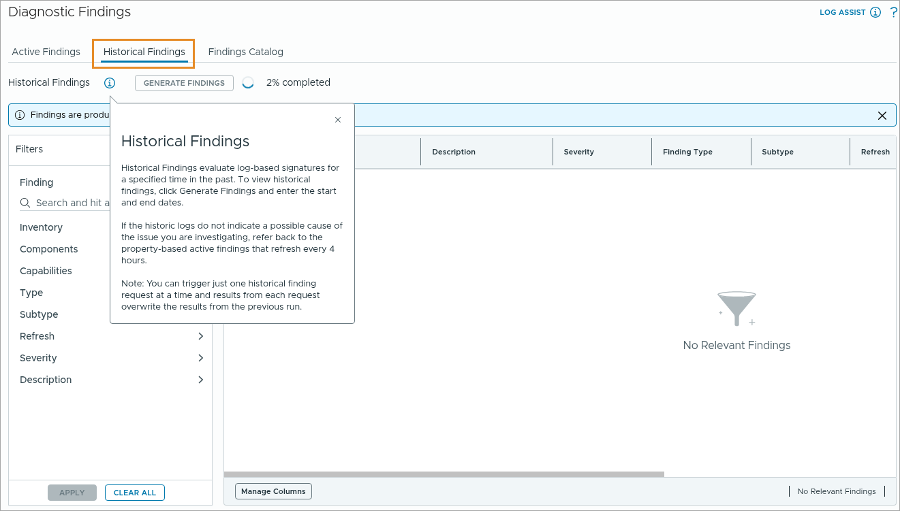
Historical Findings
Diagnostic Findings collects data from all VCF components, such as events, properties, and logs, which help you identify existing or potential issues in your environment.
Notes:
TalkTrack:
This discussion compares active findings with historical findings. Diagnostic findings offer a clear representation of alerts organized by their level of severity. VCF Operations 9.0 features a powerful diagnostic rule engine for analyzing logs and generating comprehensive reports. This engine evaluates rules and scans log data, producing external events that represent identified issues. The Active Findings section displays a current list of problems detected in relation to known issues. Conversely, Historic Findings assess log-based signatures for a specific past time frame. These findings align with various standards and best practices. They encompass compliance with specific security guidelines, adherence to deployment best practices, and identification of known product issues. Such findings help ensure components and services are functioning as expected. Active findings identify issues that are currently present or have recently occurred. They provide real-time information for immediate action. Historical findings, in contrast, provide insight into past events. They are valuable for understanding trends, root cause analysis of intermittent problems, and long-term planning. An active finding that is resolved transitions into a historical record.
<End>
If you investigate an issue that has occurred beyond the 24-hour window of active findings, for example, during the weekend, you can use the Historical Findings option to evaluate log-based findings for a specified time in the past and for the relevant inventory. With Historical Findings, you can also check if an active finding that you have fixed based on the recommendations has been fully addressed, and also see what specific fix you used for a given issue. You can also export the Historical Findings report for auditing purposes or for sharing with other teams or subject matter experts.
Note: You can run only one Historical Findings query at a time and results overwrite previous reports. For new installations or migrated systems, Active and Historical findings might not immediately show results.
You can also export the Historical Findings report for auditing purposes or for sharing with other teams, or subject matter experts. The Export button is on the Active Findings tab, but the export operation captures historical logs as well under the Manual Historical category in the refresh Type column in the file vcf_operations_diagnostic_findings_summary.csv that you get from the export package.
For new installations or migrated systems, Active and Historical findings might not immediately show results. Click Findings Catalog to see the complete list of signatures that are being checked in your environment at any given time. In 4 hours, If you see null results, your environment is healthy.

Slide 13
Findings Catalog
Findings Catalog lists potential issues that can impact your environment. Each finding provides guidance for remediation.
Notes:
TalkTrack:
The Findings Catalog presents a compilation of potential environmental issues, with each entry offering clear guidance for resolution. This catalog provides a detailed view of detected issues. Within VCF Operations, the summary section provides an overview of a selected finding. This overview categorizes findings by their level of urgency, their nature (such as security or availability concerns), and the specific product areas they impact. A dedicated tab offers explicit instructions for addressing the identified problem. Controls enable filtering the displayed findings, allowing for a focused review on particular components or inventory elements.
<End>
The Summary tab in VCF Operations provides an overview of the selected finding. The summary categorizes findings by severity (for example, Immediate, Warning), type (for example, Security, Availability), and impacted product areas.
The Recommendations tab provides information about fixing the issue.
Filters enable you to focus on specific components or inventory items.

Slide 14
Diagnostic Findings Self-Help Flow
The idea behind a VCF Health flow is to surface issues that require immediate attention in a simple and structured manner in the customer's environment.
Notes:
TalkTrack:
VCF Health aims to highlight environmental issues requiring immediate attention through a simplified, structured process. The overarching diagnostics configuration can be managed using a JSON solution configuration file. This allows for deactivating specific rules or establishing default settings tailored to the environment. Considerations include defining sizing limits for the environment, with a recommended practice involving separating workloads to optimize both performance and computation time. VCF Diagnostics facilitates this by segmenting the environment into logical groups, such as by geographical location or business function, to prevent excessive resource utilization. Information is available regarding the maximum number of objects per workload type for VCF Operations collectors. An alert signifies when a threshold is exceeded, prompting a decision to segregate workloads or increase limits, if beneficial for the setup. Further details on JSON solution configuration for sizing, including collector sizing parameters, are accessible. The self-help flow guides problem resolution. Begin by identifying a potential operational concern. Access overall findings to understand the scope. Distinguish between current and past issues for investigation. Examine detailed findings and supplementary information. Consult a troubleshooting guide if a direct resolution is not apparent. Determine appropriate next steps for remediation.
<End>
Overwriting the Diagnostics Configuration: By using a JSON solution config file, you can manage some parameters of VCF Diagnostics, such as deactivating rules or setting defaults for some tasks, depending on your environment. You can also consider sizing limits for your environment. Best practice is to segregate workloads to optimize performance and computation time of VCF Diagnostics. This means dividing an environment by some logical grouping, such as by geography or business function for example, to avoid excessive use of resources for the Diagnostics collector if you use the whole stack. Part of this strategy is the ability to manage the limit of the number of objects that are part of such workloads and setting up a VCF Operations collector for each workload. You see an alert for the threshold of the max object count that you must consider when segregating workloads, which gives you a decision point whether to segregate workloads or increase the limit if this makes sense for your setup. For more information on how to use the JSON solution config file, see KB 369791. For sizing considerations, see KB 397782 and the attachment with VCF Operations collector sizing parameters.

Slide 15
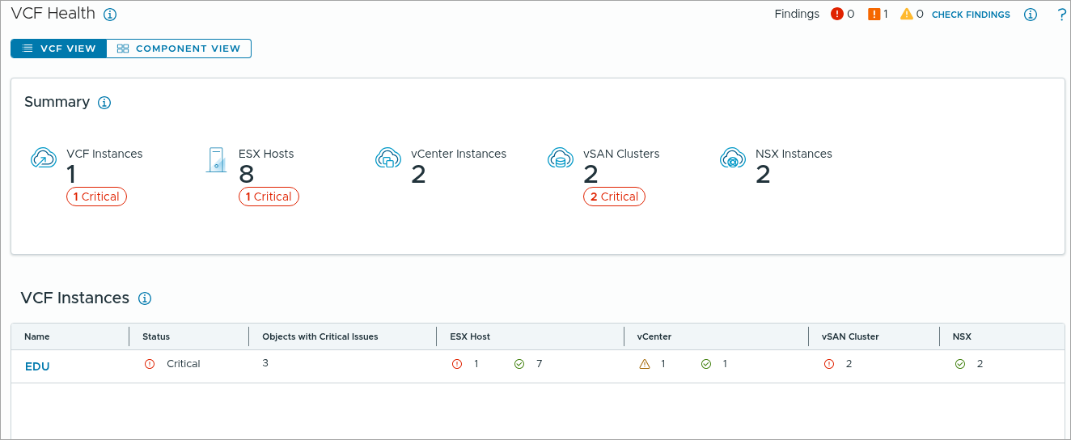
Monitoring the Operational State
The idea behind a VCF Health flow is to surface issues that require immediate attention in a simple and structured manner in the customer's environment.
Notes:
TalkTrack:
VCF Health is designed to present critical environmental issues in an understandable and organized format, prompting immediate attention. Problem indications appear at three levels: overall system, VCF Management, and individual Workload Domains. At the highest level, sufficient data is displayed to indicate a high-priority problem affecting one or more VCF Instances. Operators typically expect alerts when such conditions arise. For version 9.0, comprehensive documentation will be provided, without automated alert generation at this point. The health overview section summarizes the status of VCF Instances, ESX Hosts, vCenter Instances, vSAN Clusters, and NSX Instances. A detailed table also provides specific information for VCF Instances, including their current status, the number of objects experiencing critical issues, and the counts of associated ESX hosts, vCenter components, and vSAN clusters.
<End>
Issues are surfaced at 3 levels: global, VCF, Management or Workload Domain. At the global level, the user is shown enough information to know that there is a high priority issue impacting one or more of their VCF Instances. Users will typically expect to be notified when such an issue exists. In 9.0, we'll provide documentation and no automation for alert creation.

Slide 16
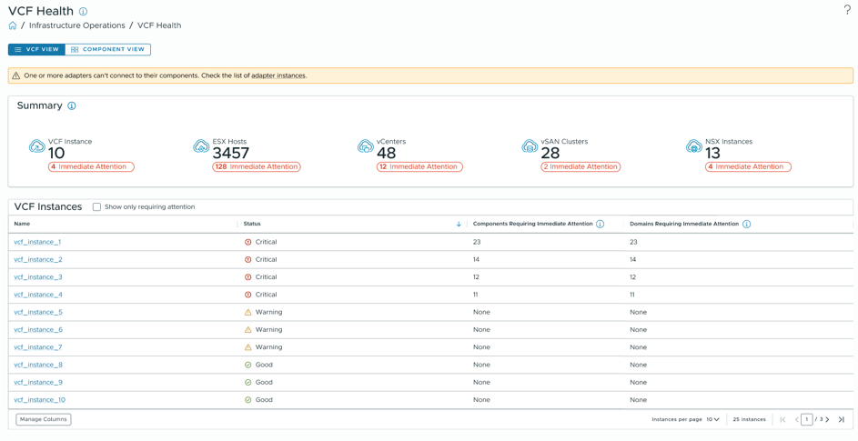
Monitoring VCF Health Status
You can view the overall health status of the VCF deployment and navigate to individual components to get more detailed information.
Notes:
TalkTrack:
A comprehensive health status of the VCF deployment is available, allowing drilling down into specific components for detailed insights. The health overview provides a summary of VCF Instances, ESX Hosts, vCenter Instances, vSAN Clusters, and NSX Instances. It also presents a table with specific information for VCF Instances, including their status, the number of components requiring immediate attention, and the number of domains needing immediate attention. An important point relates to adapter connectivity; if one or more adapters cannot connect, investigate the adapter instances. The system's hierarchical structure allows for exploring health data pertaining to workload domains, vCenter, clusters, and virtual machines.
<End>
You can navigate the hierarchy to view health information for workload domains, vCenter, clusters, and VMs.

Slide 17
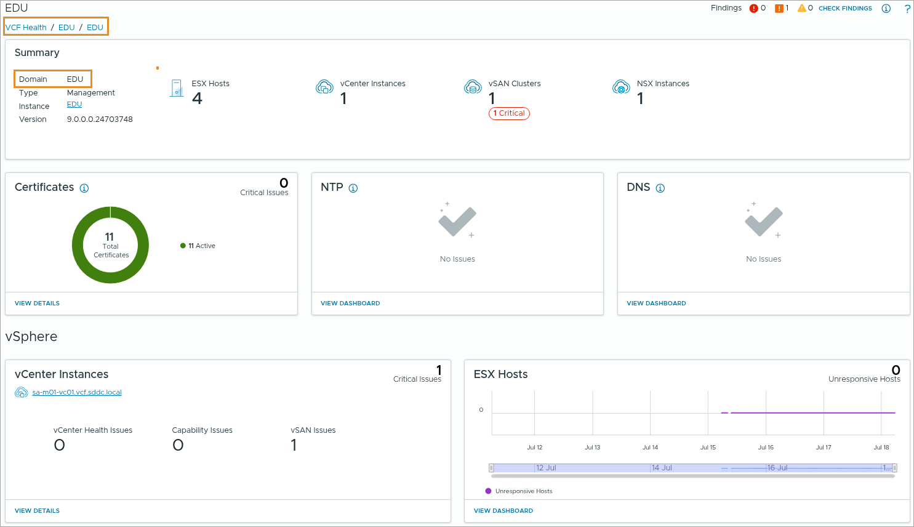
VCF Instance Health
The idea behind a VCF Health flow is to surface issues that require immediate attention in a simple and structured manner in the customer's environment.
Notes:
TalkTrack:
VCF Health aims to highlight environmental issues requiring immediate attention through a simplified, structured process. The summary section provides details on the domain, type, management instance, and software version. It also gives an overview of the number of ESX Hosts, vCenter Instances, vSAN Clusters, and NSX Instances within the environment. Information on system certificates is available, indicating the total count and any critical issues. Both NTP (Network Time Protocol) and DNS (Domain Name System) sections show no current issues. Under vSphere, details for vCenter Instances include their health status, capability issues, and vSAN issues. For ESX Hosts, the display tracks unresponsive hosts over time, presented as a historical graph.
<End>
In the above screenshot, EDU VCF Instance Health details are displayed.

Slide 18
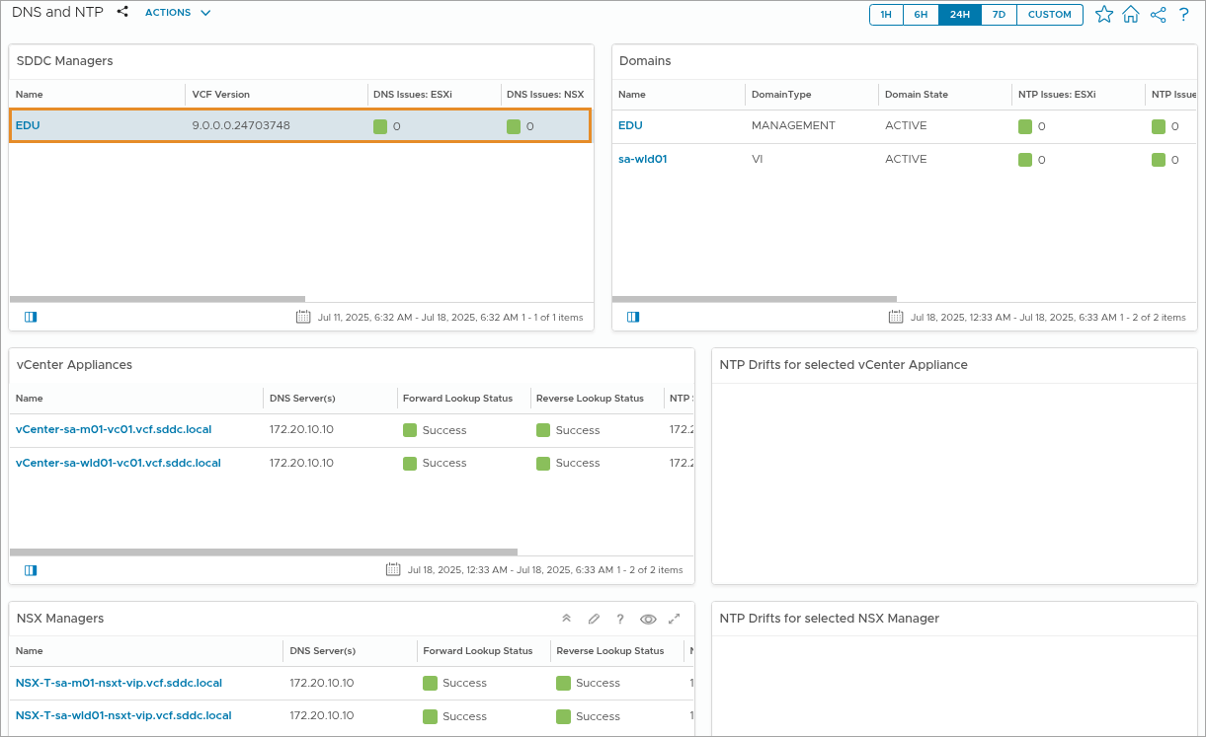
NTP and DNS Configuration Dashboard
With Diagnostics, you can see if NTP is not configured or is out of sync, as well as the DNS lookup issues for each object in your environment.
Notes:
TalkTrack:
The diagnostic tools can identify if NTP is incorrectly configured or out of synchronization, along with any DNS lookup problems for each object within the environment. It is important to monitor NTP and DNS settings consistently, as neglecting them can lead to issues like time drift and reverse lookup failures, potentially impacting vSphere migration tools. For instance, failing to set up DNS reverse lookup in some environments can result in insecure connections or integration problems. Only components that are accessible and configured are included in the displayed information. To confirm the NTP server configuration and verify components across the VCF deployment, use the dashboard link provided.
<End>
For NTP and DNS, even though you configure these settings during deployment for fresh installations, or by migrating or importing existing infrastructure, if you do not monitor them over time, you might end up with series of issues that NTP drift and DNS reverse lookup might cause, such as failing vSphere vMotion tasks.
For example, if you do not set up a DNS reverse lookup, in some environments you get such connections labeled as insecure, which can break certain integrations with errors that no secure connection can be established. With Diagnostics, you can see if NTP is not configured or is out of sync, as well as the DNS lookup issues for each object in your environment.
NTP On the NTP card, you see if NTP is not configured on some components and you can use the dashboard linked to the tile to check which NTP server you must use to configure NTP, and verify that components within each VCF deployment are configured with the correct NTP servers. Note: The count of configured components only includes components that are accessible. You also see the NTP server drift, which is computed for each component as follows: 1. Fetching the current time from the component 2. Subtracting the current time of the VCF Operations collector performing this check 3. Adding the result to the difference already accrued in the collector’s time drift from its NTP server For example, if the current time from the component minus the current time of the VCF Operations collector equals 35 seconds, and we add 35 seconds to the difference already accrued in the collector’s time drift, say another 35 seconds, the time drift will be larger than a minute and you will see it on the card. This calculation is performed every 5 minutes for vCenter and NSX Manager, and every 6 hours for ESX. Note: You might see some transient discrepancies between VCF Health and the VMware Infra Health Overview dashboard that shows NTP configuration data, because the Infra Health dashboard gets data from the SDDC Manager every 24 hours, while Diagnostics gets data from the individual components at maximum 6 hours. If NTP drift is null, it shows as > 1 minute?
On the DNS card, you see if DNS is not configured on some components and you can use the dashboard linked to the tile to check which DNS server you must use to configure DNS and verify that components within each VCF deployment are configured with the correct DNS servers. Note: The count of configured components only includes components that are accessible. You also see a count of failed forward and reverse lookups, evaluated based on the DNS server with which the VCF Operations appliance is configured. The DNS lookups report failure if the PTR or A record lookup do not return a value. Note: You might see some transient discrepancies between VCF Health and the VMware Infra Health Overview dashboard that shows NTP configuration data, because the Infra Health dashboard gets data from the SDDC Manager every 24 hours, while Diagnostics gets data from the individual components at maximum 6 hours.

Slide 19
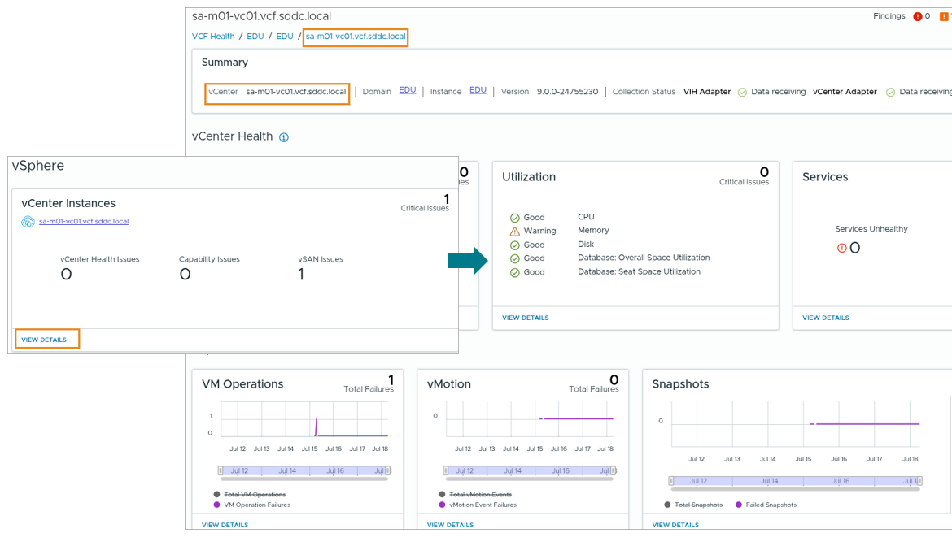
About the vCenters Pane
The vCenters widget displays the vCenter Health and a few capabilities such as Connectivity, Utilization, and Services.
Notes:
TalkTrack:
VCF Health provides essential data for monitoring and reporting, serving as a foundational element in VCF environment management. The diagnostic capabilities assist with tasks and add value by supplying information for reachability, resource utilization, and services that may transition from legacy tools. Given the complexity and size of VCF deployments, managing multiple vCenter instances for reachability can be challenging, especially when confirming all aspects, including user interfaces and API. While API calls to a vCenter instance might succeed, the vSphere client could indicate issues with vCenter services or its database. One can drill down into data for each reachability alternative. If not well-versed with such data, selecting the troubleshoot button reveals a detailed report. A comprehensive report on possible issues with vCenter services, performance metrics, disk space, CPU usage, and configuration from a scalability perspective is available. The troubleshooting option also offers a roadmap to isolate networking issues, provides recommendations for general troubleshooting, and supplies the specific information needed for a well-informed and detailed support request, if necessary. Regarding resource utilization, diagnostics measures thresholds for CPU, memory, disk, and database space usage, allowing for early identification of issues stemming from memory leaks or scalability problems. This enables proactive resolution before problems escalate. VCF Health includes CPU, memory, and disk metrics on the utilization dashboard under VCF Health, specifically for environments migrated from vCenter 8.0 Update 3 and later. Concerning services, the diagnostic information monitors critical vCenter services. Beyond vCenter, key support generating areas include workloads, deployments and updates of virtual machines, virtual machine snapshots, and vSphere vMotion tasks.
<End>
vCenter Health: vCenter is the key object for monitoring and reporting as it is the key building block in a VCF environment. Diagnostics helps you with that task and adds value by providing data for reachability, utilization, and services that you cannot derive from legacy tools. Given the complexity and size of VCF deployments, testing multiple vCenter instances for reachability might be challenging, especially if you want to confirm all aspects - networking, user interface, and API, since one does not guarantee the rest. For example, API calls to a vCenter instance might be successful, but the vSphere Client might not be reachable, which might indicate issues with the vCenter services or the vCenter database.
Connectivity: You can drill-down data for each reachability alternative and if you are not well-versed with such data, you can click the Troubleshoot button and see a detailed report (screenshot). You see at glance a report for possible issues with vCenter services, utilization or performance, such as disks out of space, CPU usage out of limit, and configuration from scalability perspective. The Troubleshoot option also runs a traceroute to isolate networking issues, provides recommendations for general troubleshooting, and provides the specific information you need to open a very well-informed and detailed support request, if necessary.
Utilization: In the Utilization screen, Diagnostics measures thresholds for CPU, memory, disk, and database space use, so you can easily identify issues that might result from a memory leak or a scalability issue, and to proactively resolve issues before they occur. Note: VCF Health supports the CPU, Memory, and Disk metrics on the Utilization dashboard under vCenter Health only for environments that migrate from vCenter 8.0 Update 3 and later.
Services: In the Services screen, Diagnostics monitors the critical 18 vCenter services. Apart from vCenter, the key support request-generating areas are workload operations, such as deployments and updates of virtual machines, virtual machines snapshots, and vSphere vMotion tasks.

Slide 20
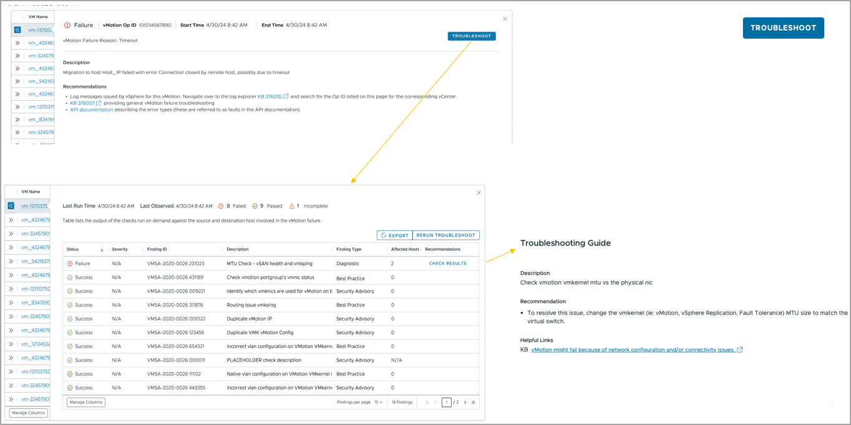
vSphere vMotion
The screenshot shows how the vMotion Event List helps troubleshoot issues faster.
Notes:
TalkTrack:
The vMotion Event List facilitates quicker troubleshooting of issues. A successful vMotion operation relies on the proper configuration of several parameters. A guided troubleshooting workflow examines each of these parameters and highlights any failures. A troubleshooting guide is available for vMotion issues. It checks the vMotion vmnic connection through the physical network interface. If problems arise, a recommendation is to adjust the MTU size of the vmnic(s) used for vMotion, vSphere Replication, and Fault Tolerance to match the virtual switch. Further assistance notes that vMotion might fail due to network configuration or connectivity issues.
<End>
A successful vMotion depends on several parameters. Guided TS Workflow checks each of these and highlights where something has failed.

Slide 21
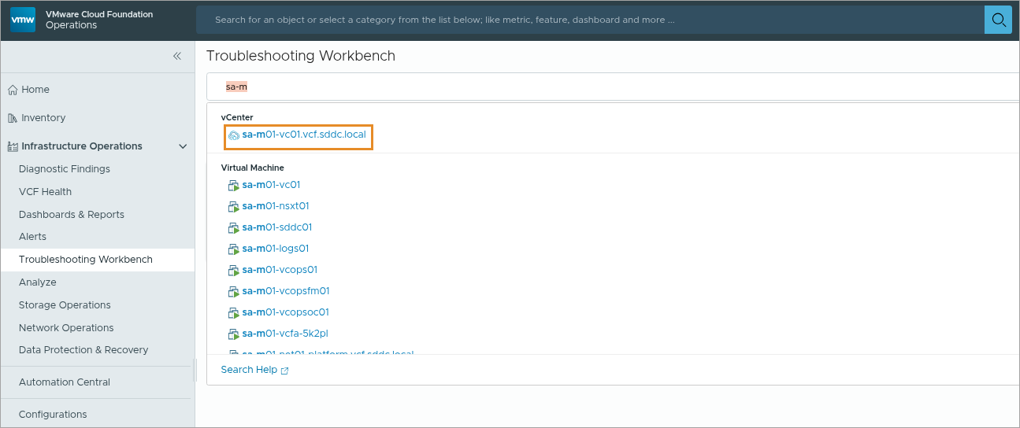
Troubleshooting Workbench
The Troubleshooting Workbench home page includes active troubleshooting sessions and recent searches. The active troubleshooting sessions do not persist after you log out of VCF Operations.
Notes:
TalkTrack:
The Troubleshooting Workbench home page provides access to active troubleshooting sessions and recent searches. Active troubleshooting sessions do not persist after logging out of VCF Operations. Text can be entered into the Search text box, which automatically generates clickable suggestions based on the input. Clicking a suggested link opens the Troubleshooting homepage with that object in context. For example, highlighting the sa-m01-vc01.vcf.sddc.local vCenter object brings the user directly to that object.
<End>
You can enter text in the Search text box, which automatically generates clickable suggestions based on the text. Click the suggested link to open the Troubleshooting homepage with that object in context. In this example, the sa-m01-vc01.vcf.sddc.local vCenter object is highlighted. Clicking sa-m01-vc01.vcf.sddc.local brings you to that object.

Slide 22
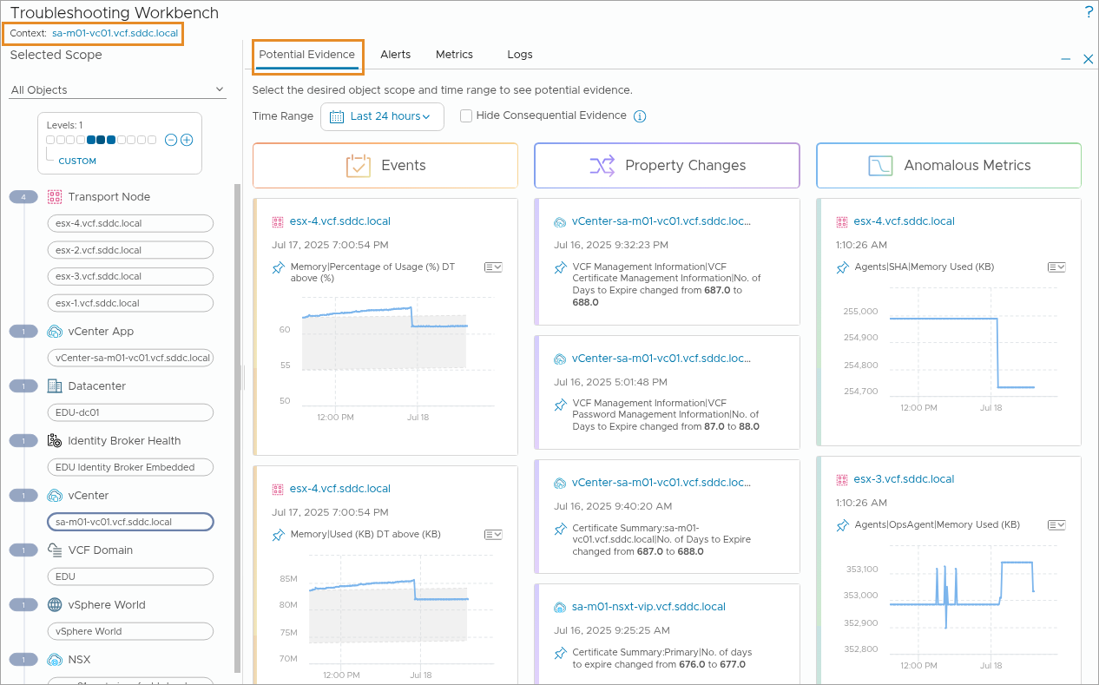
Troubleshooting Workbench: Reviewing Potential Evidence
The Troubleshooting Workbench home page includes active troubleshooting sessions and recent searches. The active troubleshooting sessions do not persist after you log out of VCF Operations.
Notes:
TalkTrack:
The Troubleshooting Workbench home page displays active troubleshooting sessions and recent searches. It is important to note that active troubleshooting sessions do not persist after logging out from VCF Operations. Potential evidence of a problem is presented for a specific scope and time. This evidence includes events, which are occurrences for metrics that have deviated from expected behavior. Property changes, significant configuration modifications, are also captured. Additionally, anomalous metrics are presented, showing drastic changes, ranked by the degree of deviation. The scope and time can be adjusted to uncover more information or to refine an investigation.
<End>
Potential evidence of a problem is presented for a specific scope and time in the form of:
Events: Events for metrics that have breached expected behavior.
Property Changes: Important configuration changes that have occurred.
Anomalous Metrics: Metrics that show drastic changes are ranked based on the degree of change. You can change the scope and time to reveal additional information or to focus your investigation.

Slide 23
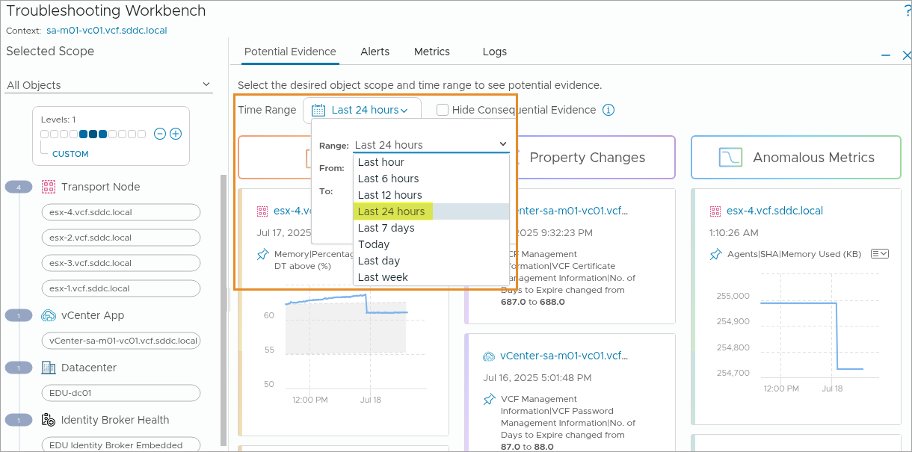
Troubleshooting Workbench: Changing the Potential Evidence
By adjusting the time range, you can uncover additional evidence that helps your troubleshooting efforts.
Notes:
TalkTrack:
Adjusting the time range allows for uncovering additional evidence to support troubleshooting efforts. The number of objects under consideration can also be modified by changing the scope.
<End>
You can also change the number of objects under consideration by changing the scope.

Slide 24
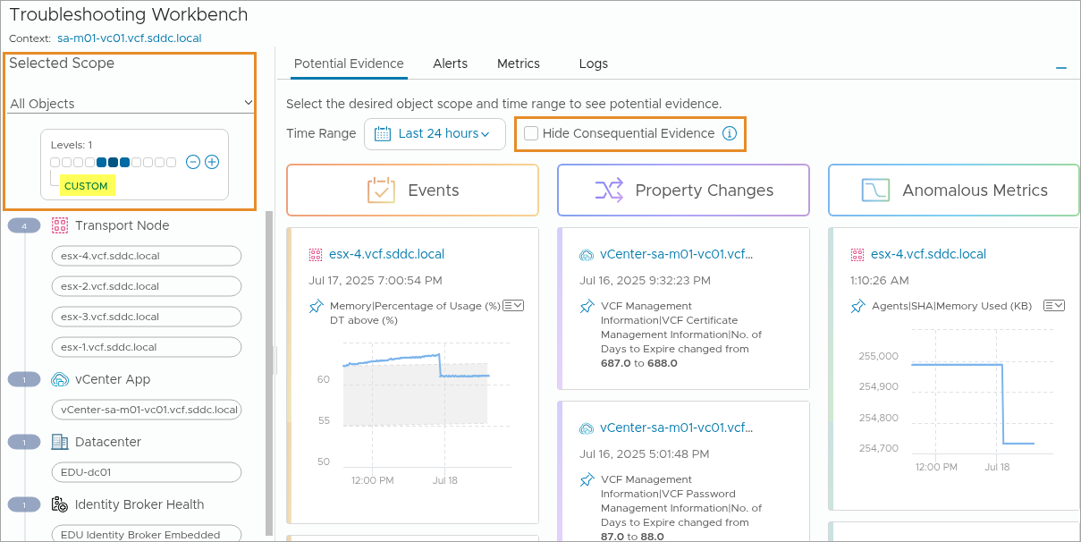
Troubleshooting Workbench: Changing the Scope
You can select only the object that you are investigating or include several upstream and downstream relationships by increasing the scope.
Notes:
TalkTrack:
One can choose to focus solely on a particular object under investigation, or expand the view to include multiple upstream and downstream relationships by adjusting the scope. As the scope is broadened, additional objects become visible within the inventory tree. There is also an option to click "CUSTOM" which opens an interactive window, providing detailed information about the selected object.
<End>
As you increase the scope, more objects appear in the inventory tree.
You can also click CUSTOM to open an interactive window that allows you to view details about the object.

Slide 25
About Log Assist
VCF Operations Log Assist provides an efficient and convenient method to attach diagnostic bundles to a support request.
You perform the following tasks with VCF Operations Log Assist:
Generate log bundles for vSphere components.
Attach diagnostic bundles to a service request and upload to the Broadcom Support Portal.
Monitor log transfers and review previous log uploads.
Notes:
TalkTrack:
Operations Log Assist offers an efficient and convenient method for attaching diagnostic bundles to a support request. The following tasks can be performed with Operations Log Assist: Log bundles for vSphere components can be generated. Diagnostic bundles can be attached to a service request and uploaded to the Broadcom Support Portal. Log transfers can be monitored, and previous log uploads can be reviewed. The VCF Log Assist capability enables users to generate and send relevant log data to Tech Support, speeding up issue discovery and improving SLA performance. Within VCF Operations, administrators authenticate to the Broadcom Support Portal and provide a Support Request ID to upload the relevant logs.
<End>
With the VCF Log Assist capability, Log Assist enables users to generate and send relevant log data to Tech Support to speed issue discovery and drive faster SLAs.
Within VCF Operations, administrators authenticate to the Broadcom Support Portal and provide a Support Request ID to upload the relevant logs.

Slide 26
Log Assist Architecture
You can generate a log bundle for any selected inventory object, and link and upload it to your support case.
Notes:
TalkTrack:
Log Assist simplifies the process of sending diagnostic bundles to VMware Tech Support. This application is built upon an API-driven architecture. Capturing and sending a diagnostic bundle to support involves specific steps. The process begins with initiating the operation from VCF Operations. SDDC Manager then collects logs from various components, including vCenter, NSX Manager, and ESX hosts. These logs are aggregated by an external log collector service. The collected bundle is subsequently uploaded to the Broadcom Support portal via a secure FTPS connection. It is crucial that the SDDC Manager, vCenter, NSX Manager, and ESX hosts can all reach the Broadcom Support Portal through port 443. The Log Assist feature enhances the ability to monitor VCF components, perform root cause analysis, and reduce downtime through efficient support engagement. It provides a streamlined approach for capturing the entire VCF environment, generating comprehensive log bundles, and attaching them to Service Requests for upload to the Broadcom Support Portal. The process includes monitoring log transfers and reviewing previously uploaded logs. This capability is back in VCF 9.0, supporting issue discovery and improving SLA adherence. An important note concerns the firewall configuration; outbound access to the Broadcom Support Portal on port 443 via FTPS is required. This ensures successful log transfer. Additionally, confirming the NTP configuration and verifying all components are deployed with the correct NTP server is a prerequisite. Diagnostics also assist in finding configuration issues. Finally, for Log Assist and the Content KB, referencing the Knowledge Base article 84647 provides further information regarding VMware Cloud Foundation Log Assist.
<End>
VMware vSphere Foundation and VCF customers sometimes need engagement with technical support engineers (abbreviated as TSEs) to troubleshoot VMware vSphere Foundation and VCF products in on-premises environments.
Often log bundles of the products need to be uploaded to dedicated TSE storage servers in Broadcom to be accessible by the TSEs for troubleshooting. Of the multiple products included in the VMware vSphere Foundation and VCF suites each has an individual interface for generating and downloading the support log bundle - some of which even require manual interaction with the terminal. On top of that uploading to Broadcom Support Portal requires using an FTP client to be used and to manually upload the files.
VCF Operations Log Assist will streamline the process from downloading the log bundle to uploading it through a workflow in the VCF Operations Console. Customers should find it easy to engage with support channels with minimal interactions. Additionally, results from diagnostic analyses could be uploaded to further assist TSEs with troubleshooting. In the future, this feature will help users determine which bundles are needed so the correct ones are uploaded the first time, thereby narrowing the timeframe Skyline Log Assist is the feature name of the same functionality currently implemented in Skyline.
For Enterprise IT Admins from VCF Ops Console provide:
A unified and simplified experience to select products to internally retrieve log bundles for and upload them to the target where TSEs can troubleshoot them.
After selecting to upload log bundles to Support Portal to allow specifying which support case (abbreviated as SC) the files must be related to based on the configured tenant during licensing configuration.
Ability to include diagnostic report based on the diagnostic findings for easier troubleshooting.
Log Assist ability for vCenter, ESX hosts (including vSAN), VCF Operations for Logs, NSX-T, SDDC Manager (VCF).

Slide 27
Log Assist Flow
You can generate a log bundle for any selected inventory object, and link and upload it to your support case.
Notes:
TalkTrack:
A log bundle can be generated for any selected inventory object, then linked and uploaded to a support case. The workflow begins by navigating to Log Assist and selecting objects from the inventory. Connectivity validation from a Cloud Proxy for Log Assist is then triggered. If the product is not enabled for Log Assist, one must navigate to the product and enable the Log Assist feature. Assuming connectivity validation is successful, a confirmation for Log Assist, ensuring all credentials are valid, is presented. At this stage, one needs to configure Cloud Proxy settings, including proxy type, address, and credentials, if required. Following this, a policy for collecting logs via Cloud Proxy is initiated. If there are issues with the proxy configuration, one must enter Cloud Proxy credentials and restart Cloud Proxy. After successful configuration, one selects the options for the log bundle. The system then alerts, preparing the log bundle. Links to download the log bundle appear on the left. On clicking the link, the download starts. Finally, one navigates to the Broadcom support portal for log upload. The process concludes with the end of the task.
<End>

Slide 28
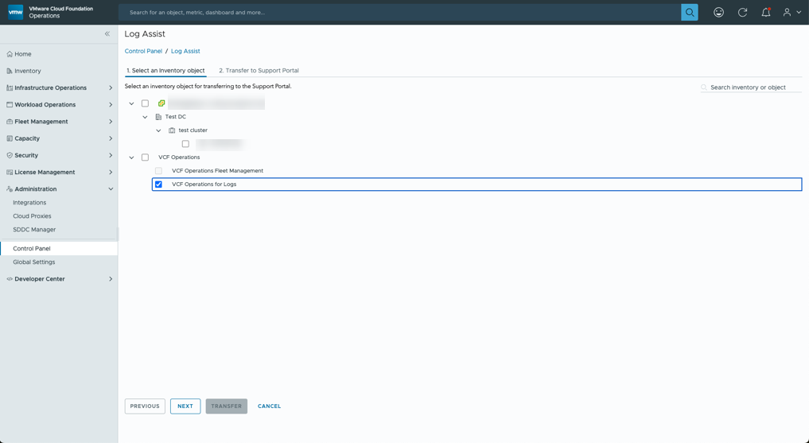
Log Assist Diagnostic Bundle Transfer
Under Log Assist in the Operations console, select the individual component log files to upload to the Broadcom Support Portal.
Need to replace the screenshots from a Log Assist configured lab
Notes:
TalkTrack:
Under Log Assist in the Operations console, individual component log files can be selected for upload to the Broadcom Support Portal.
<End>

Slide 29
Contacting Broadcom Support with Full Context
You can generate a log bundle for any selected inventory object, and link and upload it to your support case.
Notes:
TalkTrack:
A log bundle can be generated for any selected inventory object, which can then be linked and uploaded to a support case. This process helps accelerate the resolution of support cases. Log bundles can be generated, and property-based diagnostic findings can be attached automatically. If a known issue is not visible in the Diagnostic Findings that reflects a problem in the environment, and it cannot be proactively identified by examining VCF infrastructure metrics from VCF Health, one can contact Broadcom support. This contact can include relevant context and automatically generated log bundles. Linking tools are available within the Diagnostics findings tab. Key actions supported include generating a log bundle on demand, linking the bundle to a support case, utilizing logs for effective troubleshooting, and attaching diagnostic findings to a support case.
<End>
To accelerate resolution of support cases, you can use to generate log bundles and attach property-based Diagnostic Findings automatically. In case you do not see in the Diagnostic Findings a known issue reflecting a problem in your environment, and you cannot proactively identify such by drilling down to the VCF infrastructure metrics that VCF Health provides, you can reach out to Broadcom support with context and automatically generated log bundles by using a link to is available in the Diagnostics Findings tab
Attach Logs and Diagnostic Findings to Support Tickets with:
Generate a log bundle on demand
Link the bundle to a support case
Use logs for effective troubleshooting
Attach diagnostic findings to your support case

Slide 30
Lab: Monitoring VCF Health and Diagnostics
Use VCF Health and Diagnostics to monitor the environment:
Navigate the VCF Health Dashboard
View the NTP and DNS Widgets
View the vSphere Widgets
Review the Diagnostic Findings

Slide 31
Review Learner Objectives
Outline the role of VCF Health and Diagnostics
Describe the Diagnostic Findings feature
Describe the VCF Health feature
Monitor the operational state of VCF Instances
Explain Troubleshooting Workbench
Enable support teams with full context using Log Assist

